Slide 1
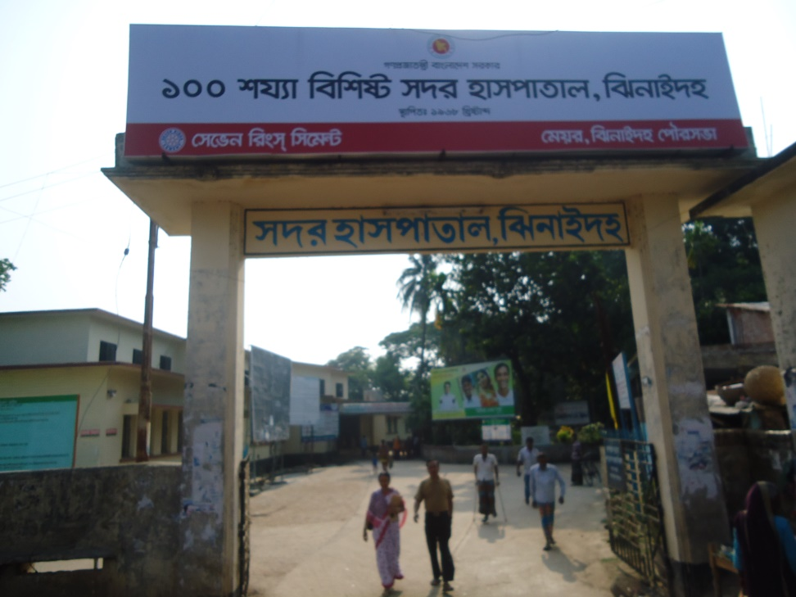
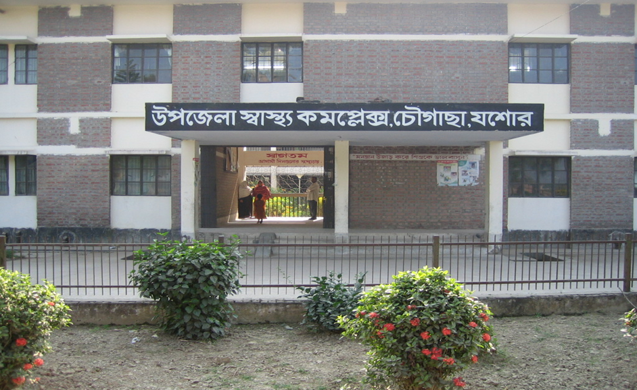
Community Support System in Chowgacha UHC & Jhenaidah Sadar Hospital
Dr. Md.Emdadul Haque
Senior Consultant (Obst & Gynae)
Sadar Hospital Jhenaidah

Slide 2

50 BEDED UPAZILA HEALTH COMPLEX
Chowgacha, Jessore.

Slide 3
Achievement of Chowgacha Health Complex
First got the idea from NIPSOM in 1991 and Foundation course in BPATC in 1992, and tried in the Lohagara UHC as MO-MCH
2. From 1996 to 2012, took initiatives to develop Upazila level standard services in Chowgacha health complex.

  Mobilized 46 additional workers from community (26 volunteer, 12 cleaners and others 8).
  EOC Beds increased from 11 to 41 by local arrangement.
  Chowgacha UHC became the best EOC center with 98.4% delivery rate in 2011.
  Chowgacha UHC achieved MDG target in 2009.
  Chowgacha Health complex is awarded for best performance in EOC form 2005 to 2014.

Slide 4
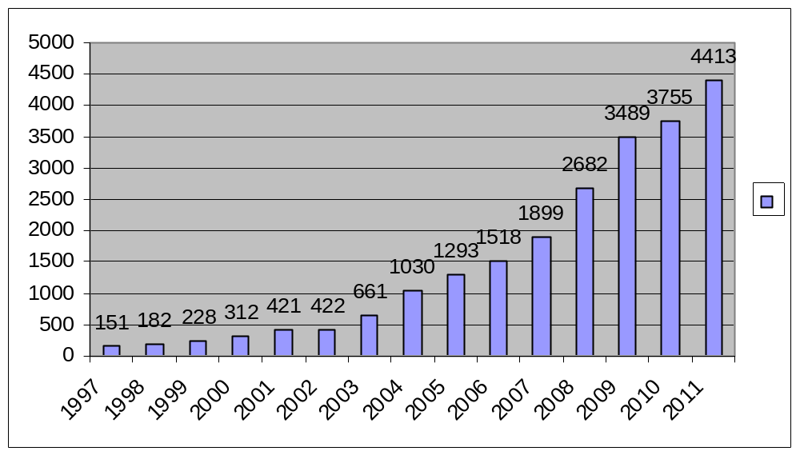
Upazila Health Complex
CHOWGACHA , JESSORE.
EOC Activities : 1997- 2011 (Hospital Delivery )

Slide 5
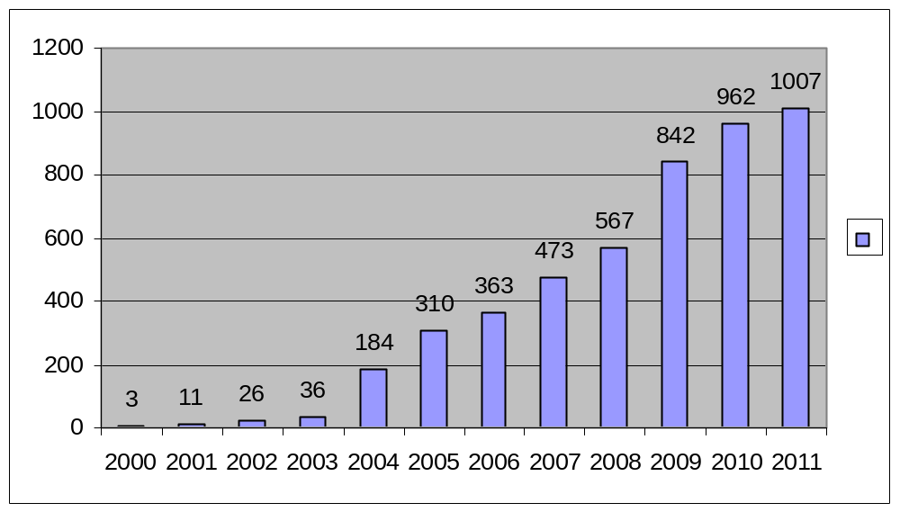
Upazila Health Complex
CHOWGACHA , JESSORE.
EOC Activities : 2000 - 2011 (Caesarian Section)

Slide 6
Upazila Health Complex
CHOWGACHA , JESSORE.
Comparative Data of Delivery of best performing EOC center of Khulna Division in 2011
SL No | Name of institute | NVD | Vacuum Del. | V. Breech | C. Section | Total
01. | Chowgacha UHC | 3346 | 34 | 26 | 1007 | 4413
02. | Ad-din Hospital Jessore. | 1124 | 0 | 0 | 1864 | 3492
03. | Khulna Medical College Hospital | 1581 | 58 | 18 | 1356 | 3013
04. | 250 bed Hospital, Jessore | 1327 | 2 | 25 | 1498 | 2852
05. | 250 bed Hospital, Kustia | 1728 | 0 | 34 | 915 | 2677

Slide 7
MDG 4 and 5 Achieved at Chowgacha in 2009
Per 1000 live Birth Chowgacha MDG Target National
MMR: .42 1.47 3.2
(MDG 5 Achieved)
IMR: 20.6 31 52
(MDG 4 Achieved)
<5 MR: 22.7 50 65
(MDG 4 Achieved)

Slide 8
Upazilla Health Complex
CHOWGACHA , JESSORE.
COMMUNITY SUPPORTED MANPOWER
TOTAL IN 2011 : 46
  Volunteers : 26
  Cleaners & guards : 16
  Others : 04
  The remunerations come from
  Outsourcing : 25
  Service provider : 21
  The amount of remuneration was 90,000/= Tk per month.

Slide 9
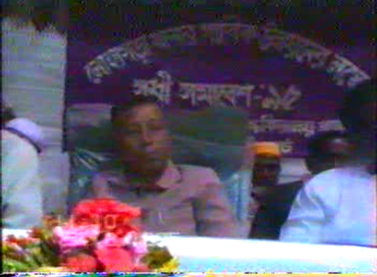
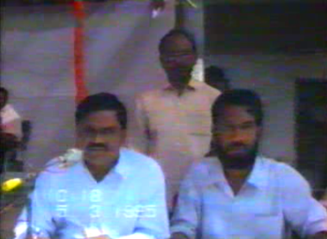
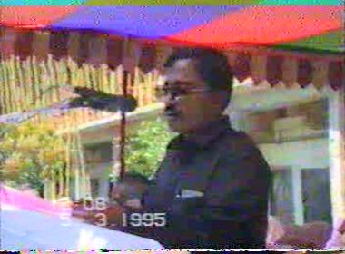
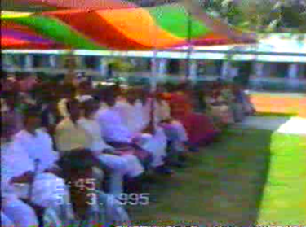
Community Mobilization Meeting at Lohagara in 1995

Slide 10
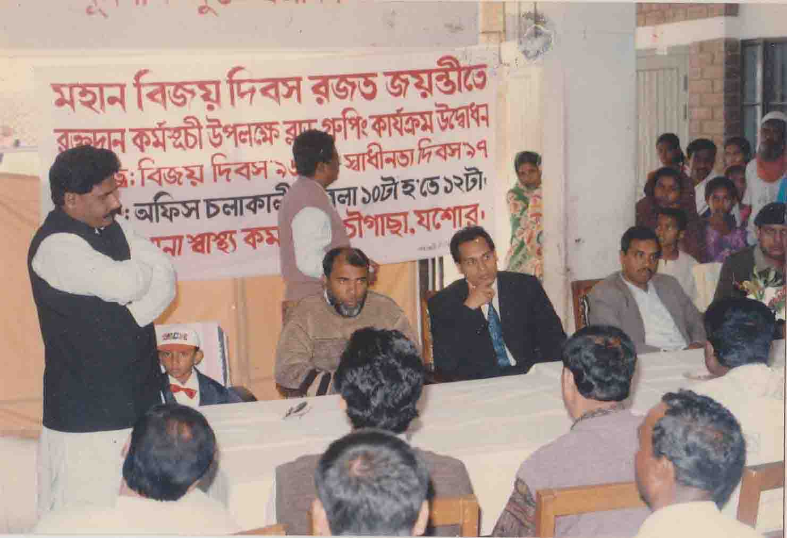
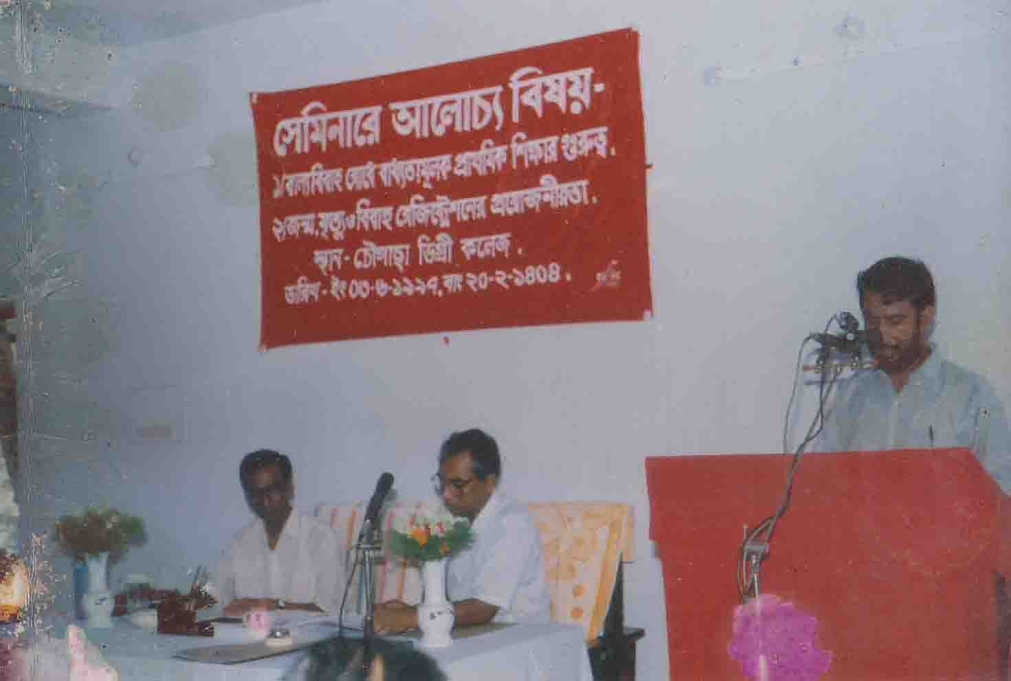
Blood donation program stared in 16 December, 1996 in Chowgacha UHC
A seminar held on basic information system of Chowgacha upazilla arranged the help of upazilla administration, Degree College and Chowgacha UHC in June, 1997. DC Jessore was the chief guest there.

Slide 11
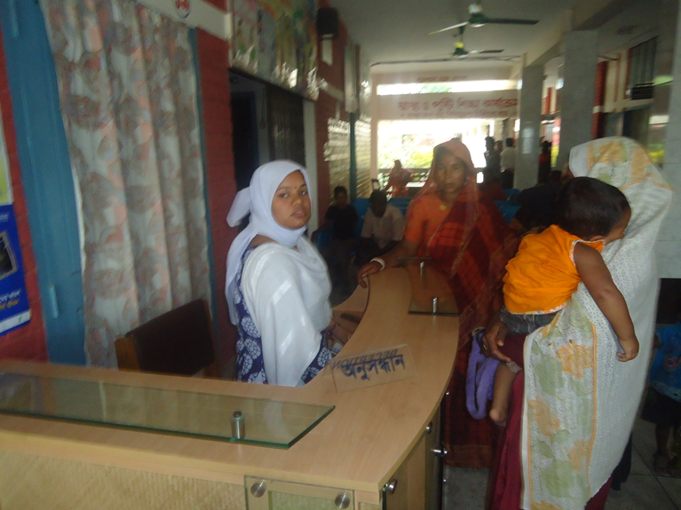
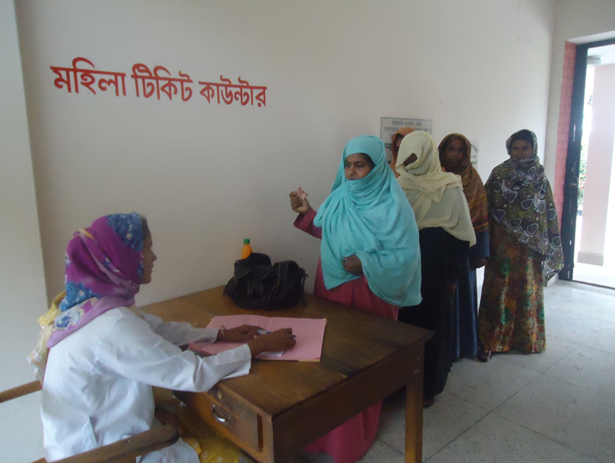
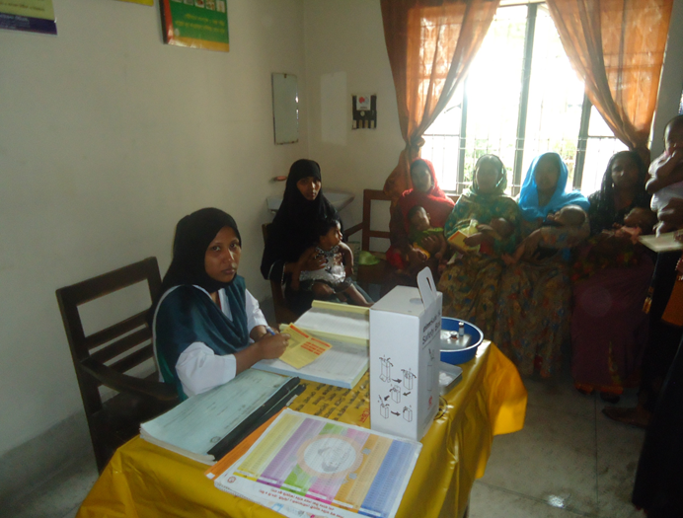
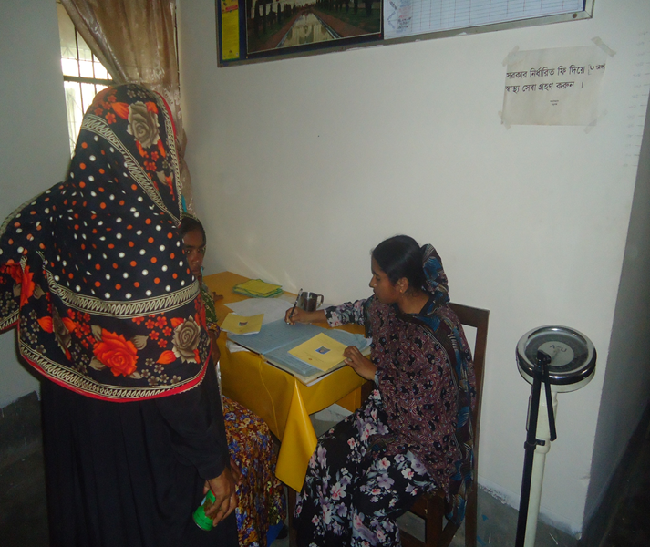

Slide 12
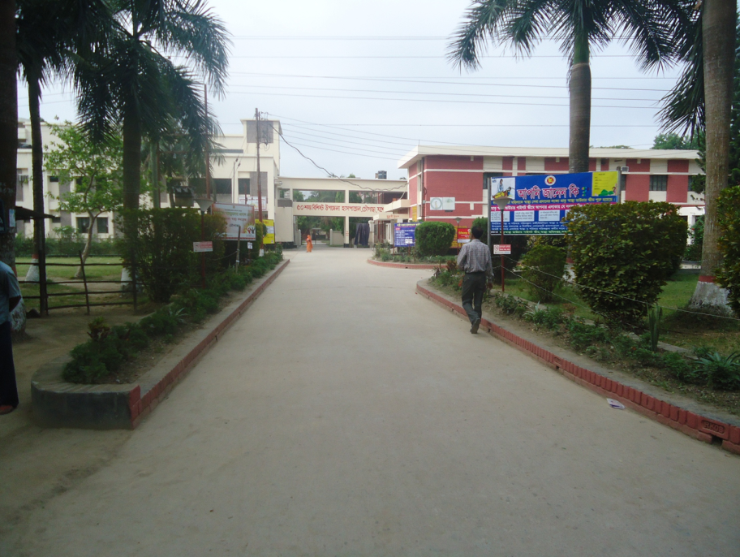
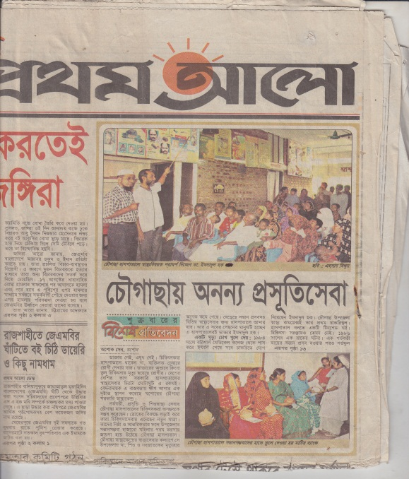
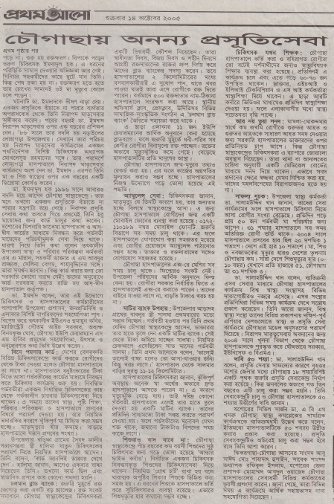
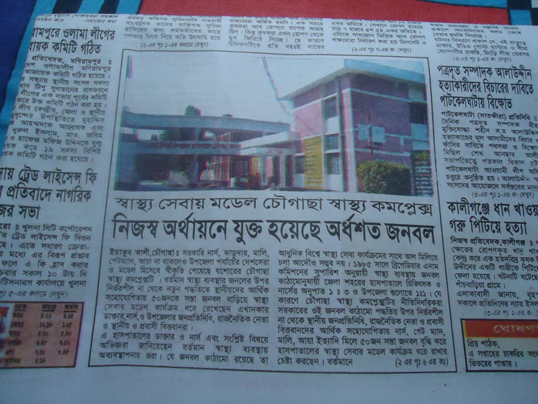
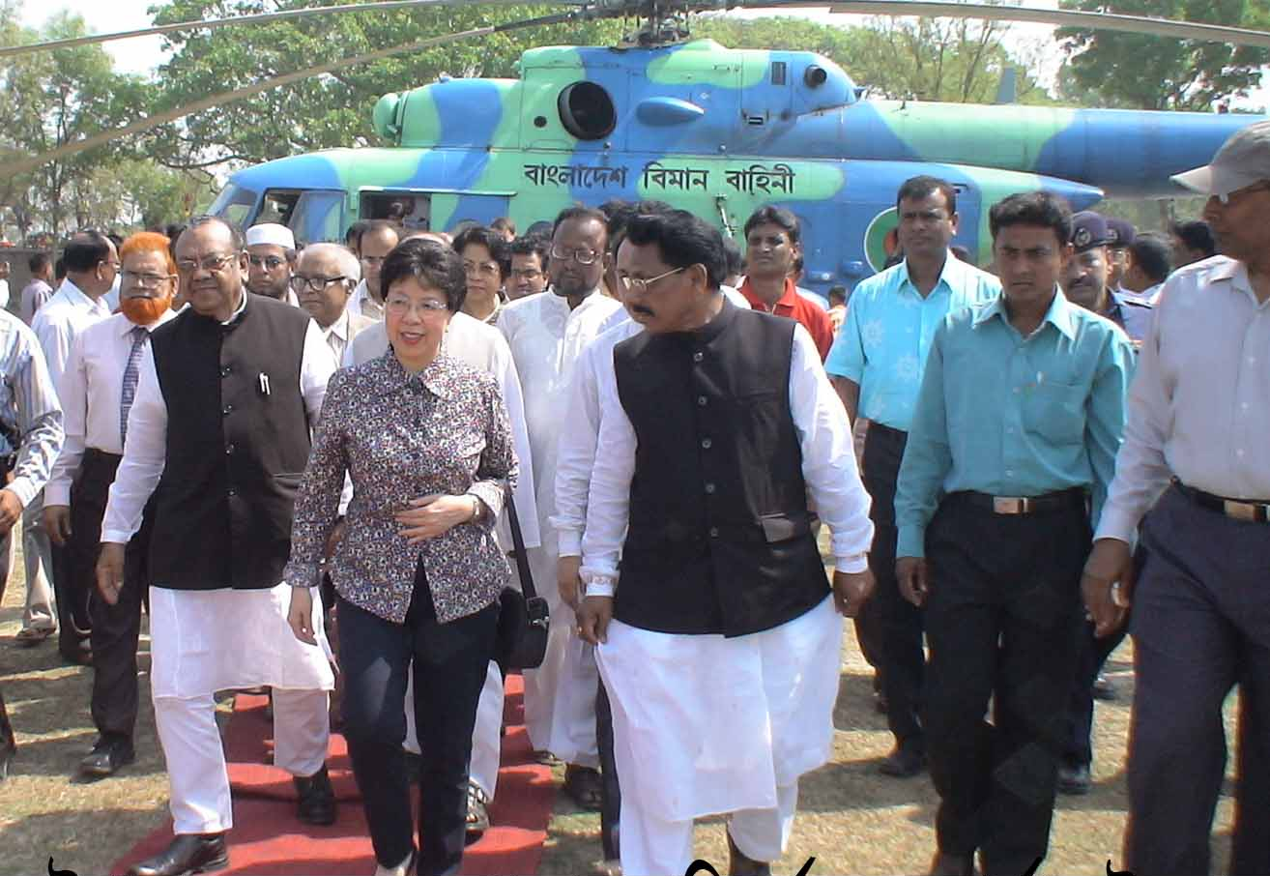

Slide 13


Community Participation in Jhenaidah Sadar Hospital
SADAR HOSPITAL, JHENAIDAH

Slide 14
Comparative data of health facilities of different country of the world
SL NO | Country | Per capita health Expenditure per year in 2014 by Govt. ($) | Doctors per 10000 Population | Nurse per 10000 Population
01 | USA | 9403 | 24 | 98
02 | UK | 3935 | 28 | 88
03 | Japan | 3703 | 23 | 114
04 | Malaysia | 456 | 12 | 33
05 | Sri Lanka | 127 | 7 | 19
06 | India | 75 | 7 | 17
07 | Nepal | 40 | 8 | 6
08 | Pakistan | 36 | 8 | 6
09 | Bangladesh | 31 | 3.6 | 2.2
From WHO website 2015

Slide 15

Sadar Hospital, Jhenaidah
Important post of Human Resources
Serial No. | Person | Post | Vacant
01 | Doctor | 40 | 21
02 | Nurse | 48 | 02
03 | MLSS | 10 | 0
04 | Ward boy | 03 | 03
05 | Ayah | 03 | 03
06 | Cleaner | 07 | 00
07 | Guard | 03 | 00
08 | Gardener | 01 | 00
09 | Electrician | 01 | 00
10 | Trolley man | 00 | 00
11 | Others | --- | ---
 | Total | 150 | 29

Slide 16
Sadar Hospital, Jhenaidah
Doctors’ Position in Sadar Hospital
Serial No. | Designation | Post | Fill-up | Vacant
01 | Superintendent | 1 | 1 | 0
02 | Sr. Consultant | 8 | 6 | 2
03 | Jr. Consultant | 11 | 6 | 5
04 | RMO | 1 | 1 | 0
05 | MO | 4 | 3 | 1
06 | EMO | 3 | 0 | 3
07 | Pathologist | 1 | 1 | 0
08 | Radiologist | 1 | 0 | 1
09 | Dental Surgeon | 1 | 1 | 0
10 | MO(Homeo) | 1 | 1 | 0
11 | IOM | 8 | 7 | 1
 | Total | 40 | 27 | 13

Slide 17
Jhenaidah Sadar Hospital, Jhenaidah
Challenges of the Hospital
Limited human resources specially 4th class cleaner only 7. No guard , gardener , ayah , ward boy , trolley man and electrician .
Inadequate all the services especially EOC and pediatric service.
Inadequate overall cleanliness.
Less coordination with local administration and community leaders .
Inadequate documentation and reporting System.
Demoralized environment.
Insecure situation for the staff and hospital.
Beautification of the hospital was neglected.

Slide 18
Community Support System in Sadar Hospital
54 manpower (Cleaner 19, Ayah & ward boy 20, Guard 7, Volunteer 5, Trolley man 3 ) get TK. 2000 to TK. 3000 per month per person supported by the community.
MP of Jhenaidah-2 donated 14 manpower support.
Doctors of the hospital and Jhenaidah town supports 17 man power.
Mayor of Jhenaidah Paurasava plays an important role in cleanliness, repaired the boundary wall, made 4 dustbins and supports 4 man power and renovation of pediatric word.
Retired secretary donated a generator for 24 hours OT service with a cost of nearly 33 thousand taka.
Chairman of Zahedee foundation supports 10 manpower and an intercom with a cost of nearly two lac taka.

Slide 19

Sadar Hospital, Jhenaidah
Bed Occupancy Rate from 1998 to 2015
Sl. No | Year | Bed Occupancy Rate
01 | 1998 | 126%
02 | 2011 | 146%
03 | 2013 | 165%
04 | 2015 | 193%

Slide 20

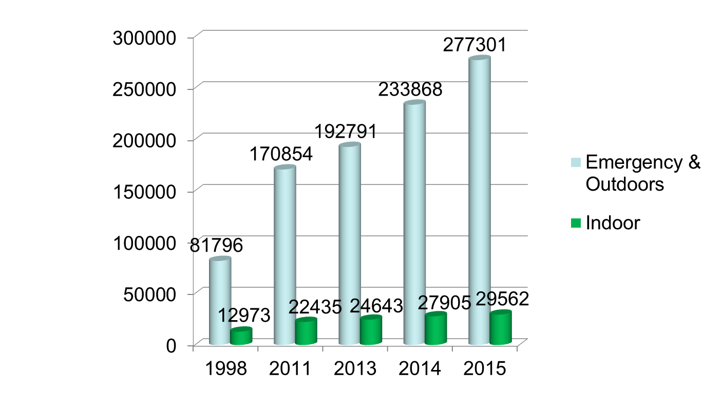
Emergency & Out Door, Indoor Service 1998 to 2015
Sadar Hospital, Jhenaidah

Slide 21
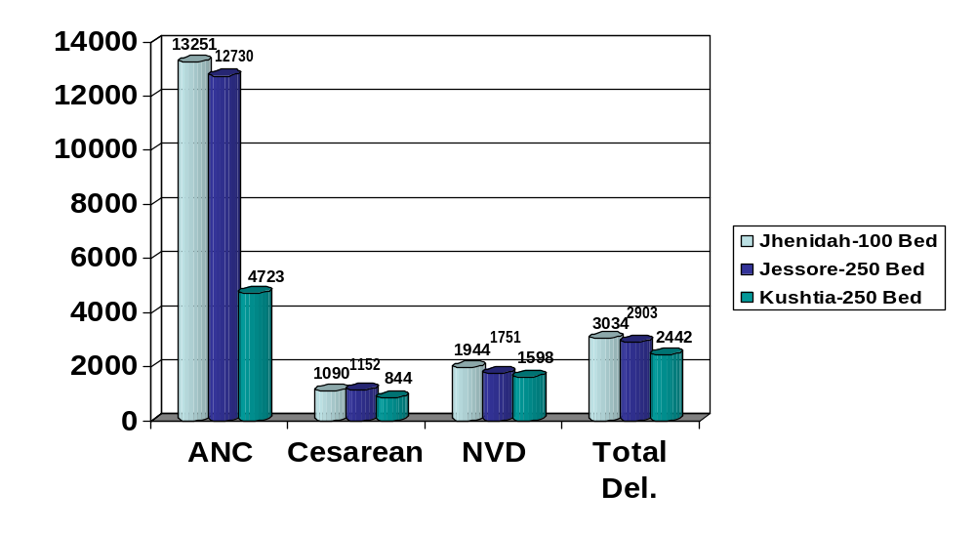
Comparative Data of EOC Service of 3 Best Performing District Hospital of Khulna Division in 2015

Slide 22

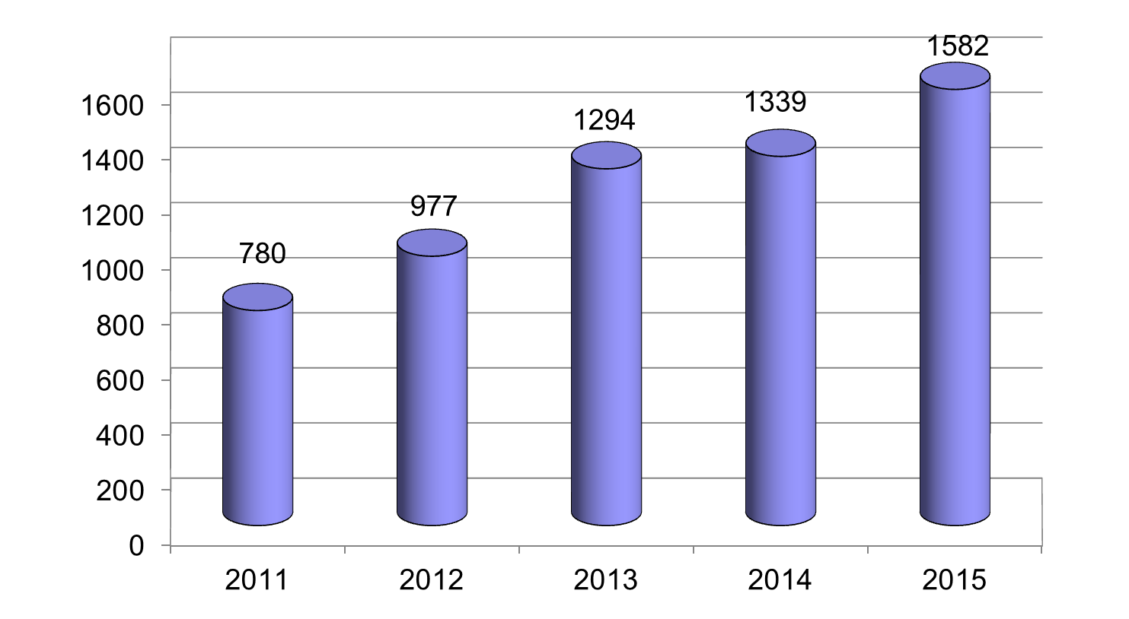
Operation Service (Major) 2011 to 2015
Sadar Hospital, Jhenaidah

Slide 23
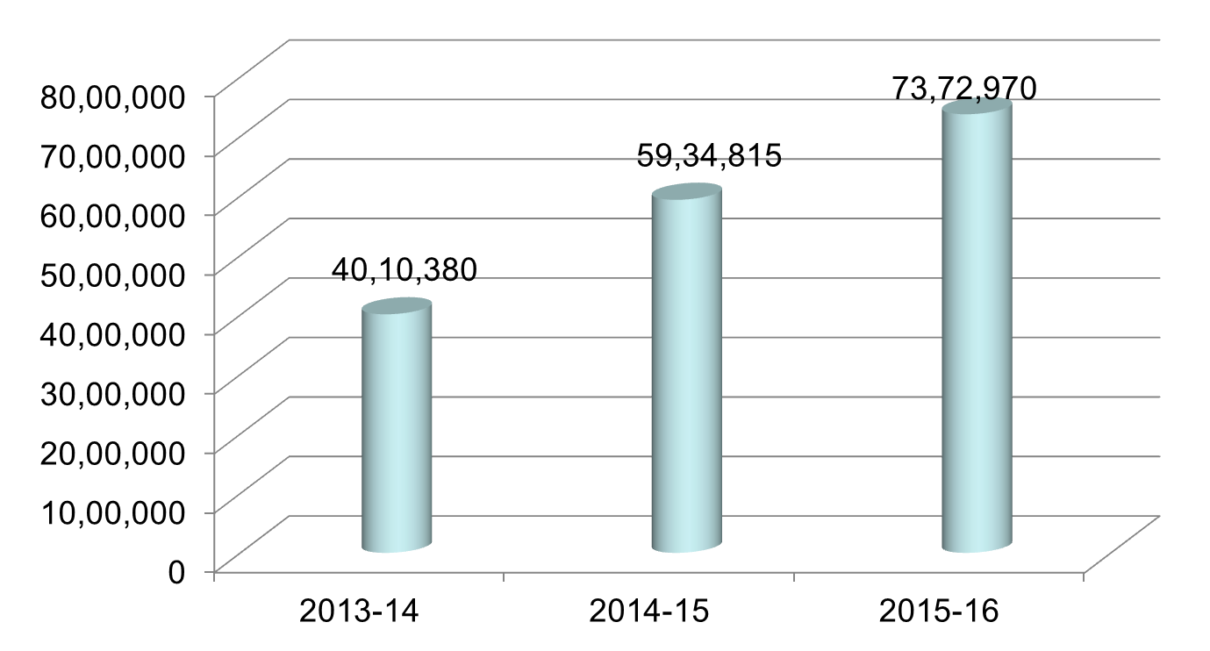
Comparative data of revenue income in Jhenaidah Sadar Hospital from 2013-14 to 2015-16 F-year
Sadar Hospital, Jhenaidah

Slide 24
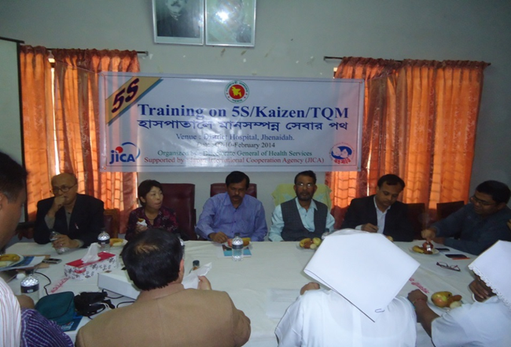
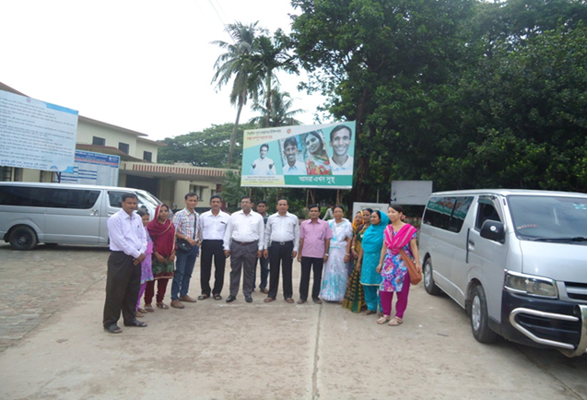
Introduction of TQM activities and Visit to Shatkhira District Hospital
  In 9 February, 2014, 5S-CQI -TQM program started by DGHS & SMPP JICA. Staff orientation on 5S-CQI-TQM process.
  5th August, 2014 an Idea sharing visit of 15 team members headed by civil surgeon at Shatkhira District Hospital with the help of JICA.

Slide 25
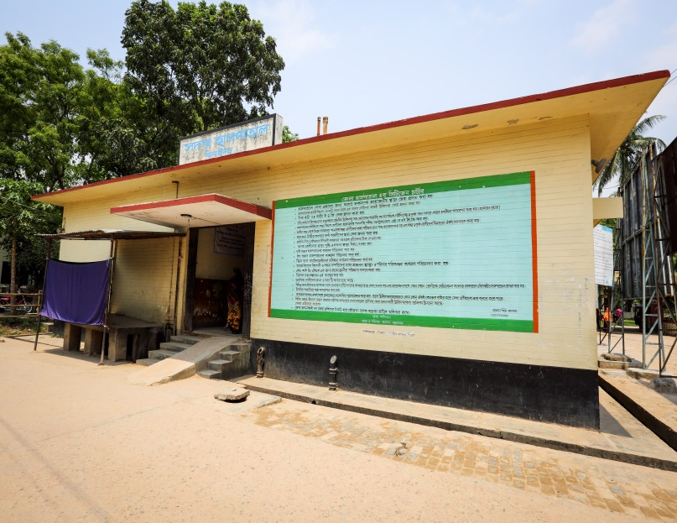
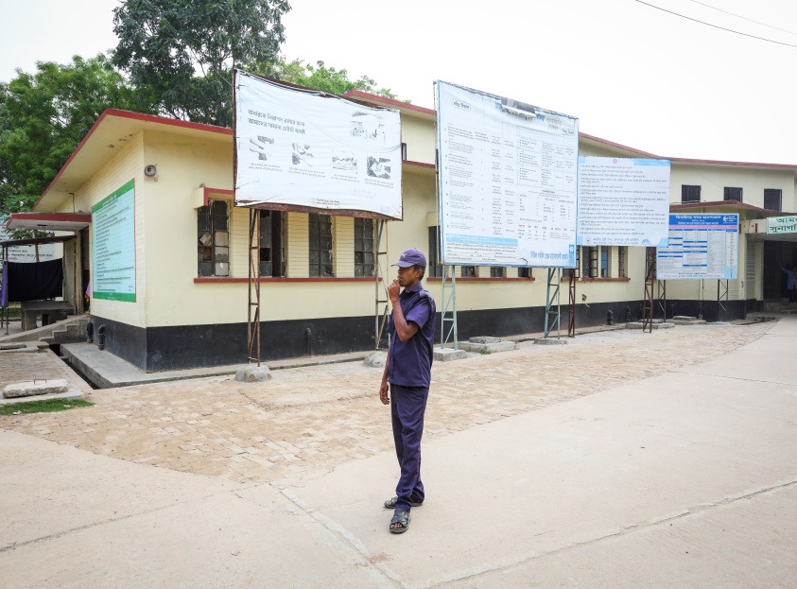
Display of citizens’ charter of Sadar Hospital.
Community supported guard is removing cycle, van and easy bike from the campus.

Slide 26
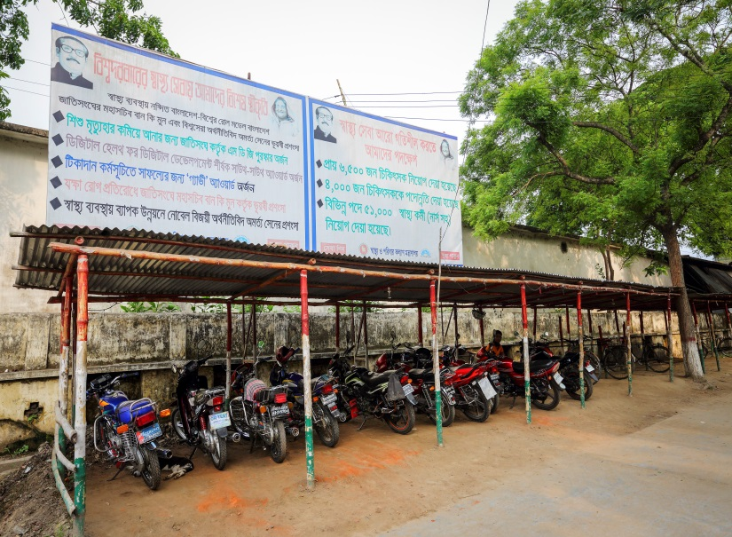
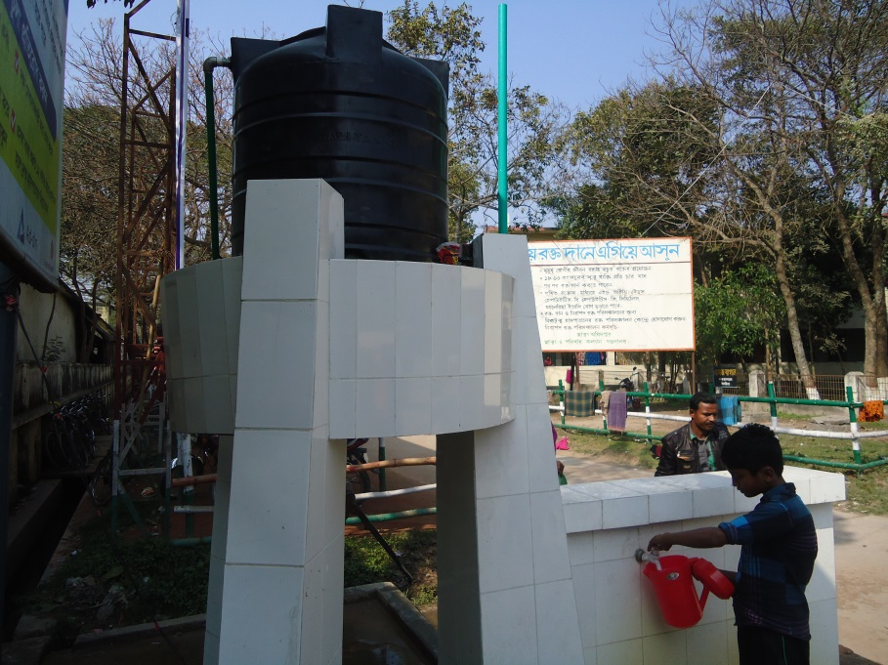
Cycle Stand
To secure the cycle and motor cycle of the patients and their attendants.
Safe drinking water supply for the patients and their attendants.

Slide 27
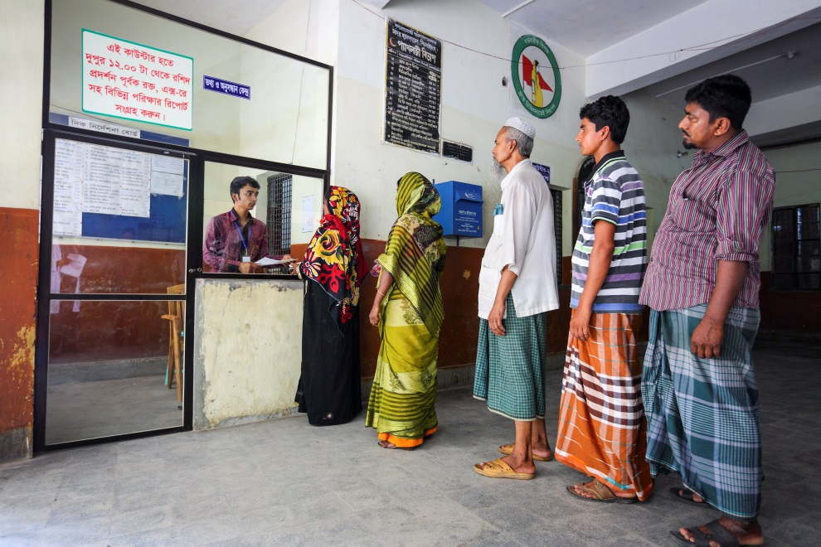
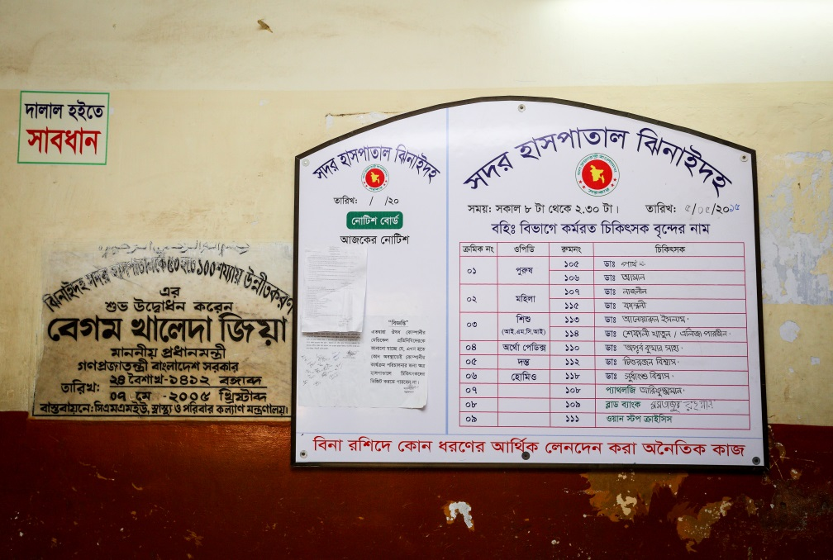
Hospital reception and information center for the patient and their attendance are developed by the community support system.
Display of the duty roaster of outdoor doctors.

Slide 28
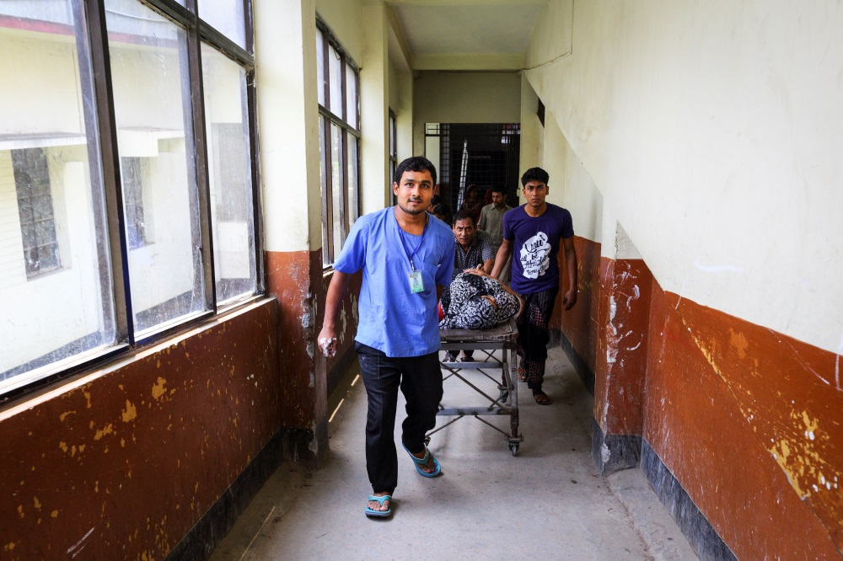
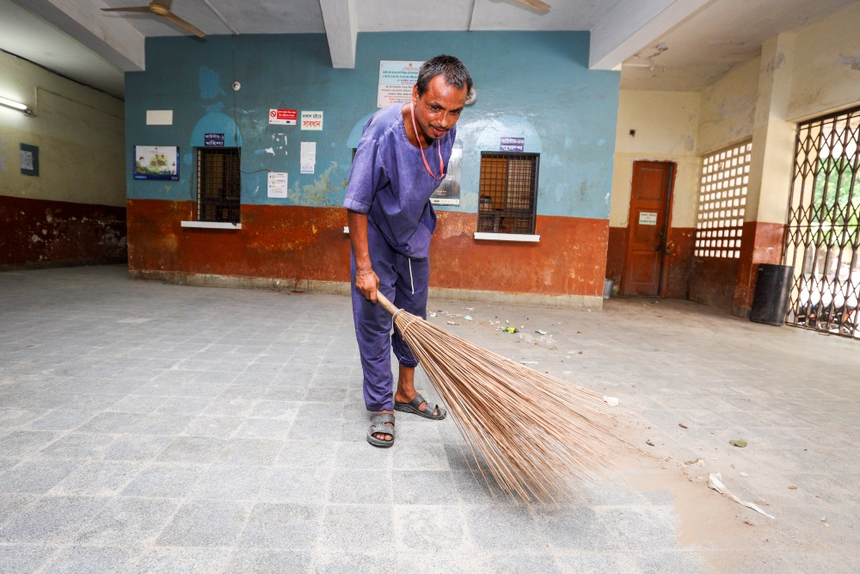
Community supported trolley man is carrying a patient.
Community supported cleaner is cleaning the hospital.

Slide 29
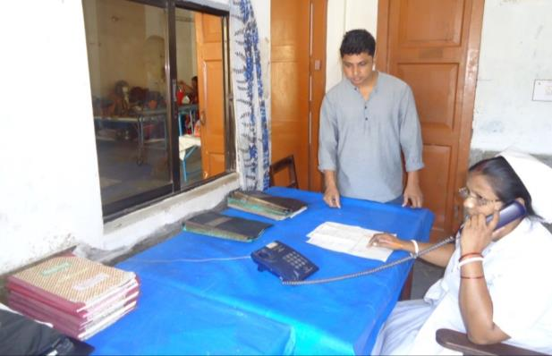
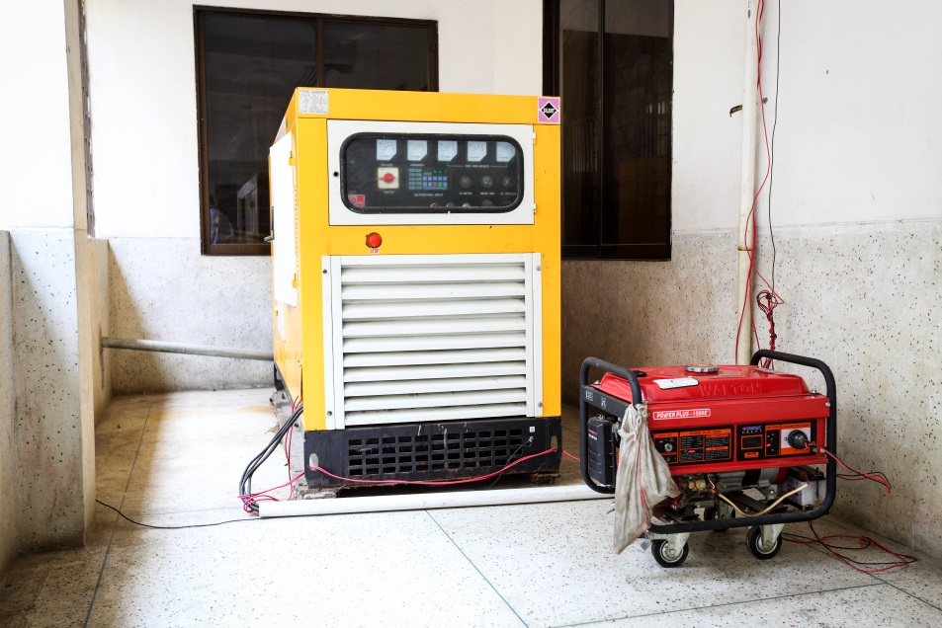
To facilitate easier communication among the hospital staff an intercom is donated by an honorable local industrialist and thus the efficiency of the service has been improved
A non-operating government generator is activated and a new generator is supplied by the community to ensure electric facility.

Slide 30
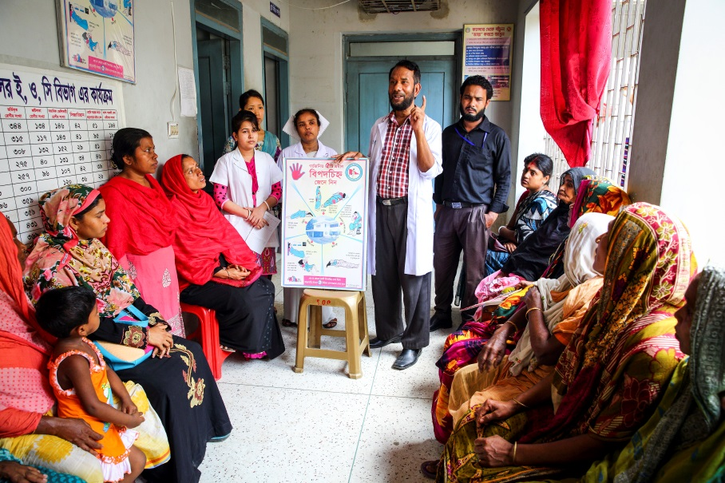
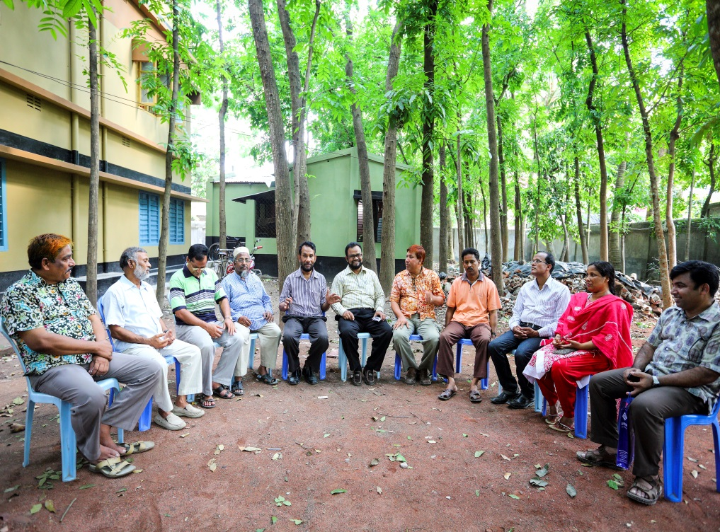
Creation of awareness by Health Education for the patients and their attendances.
Motivation of the community, the teachers, reporters, social workers, cultural activists and donors of the hospital .

Slide 31
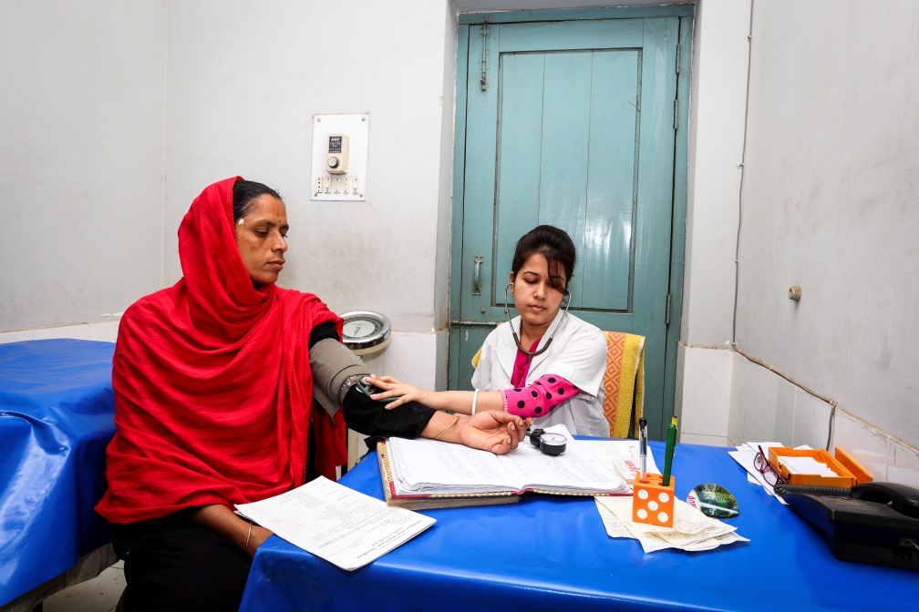
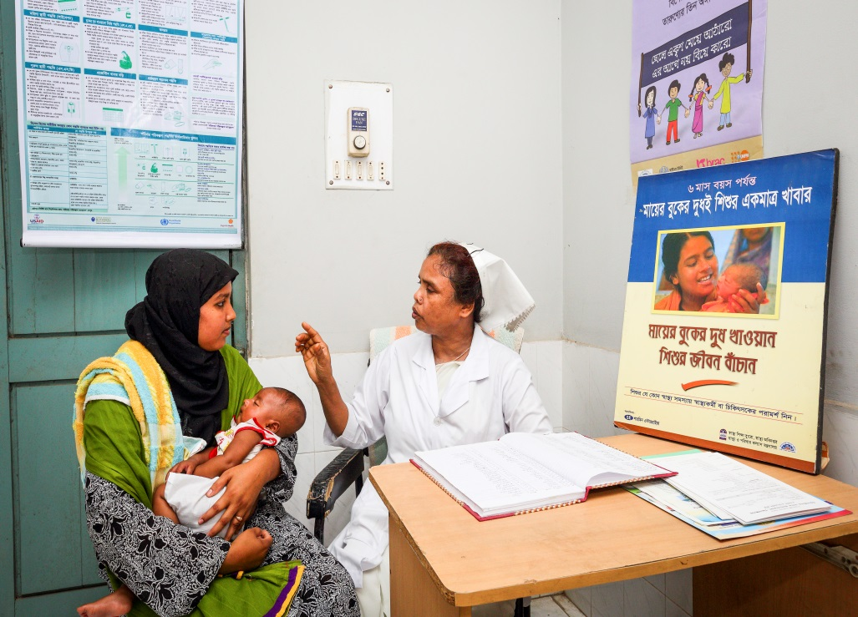
Antenatal and postnatal care of pregnant mother in antenatal corner of EOC word.
Breast feeding and family planning corner of EOC word.

Slide 32
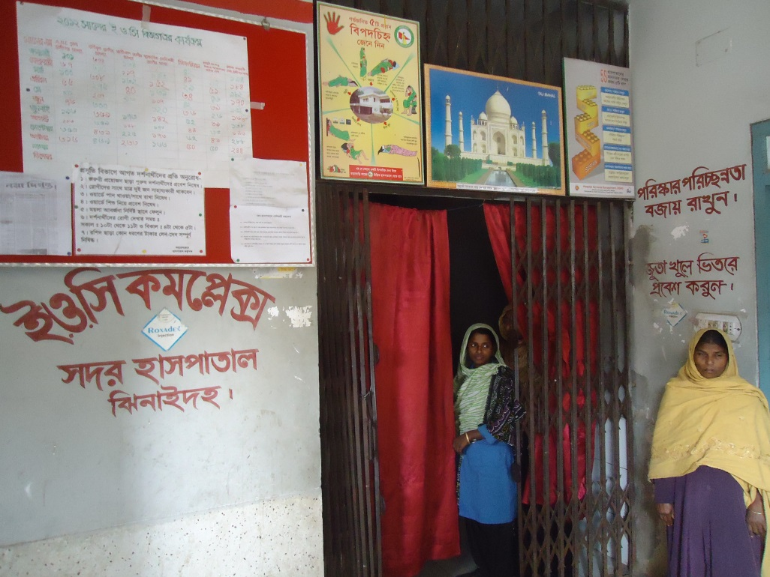
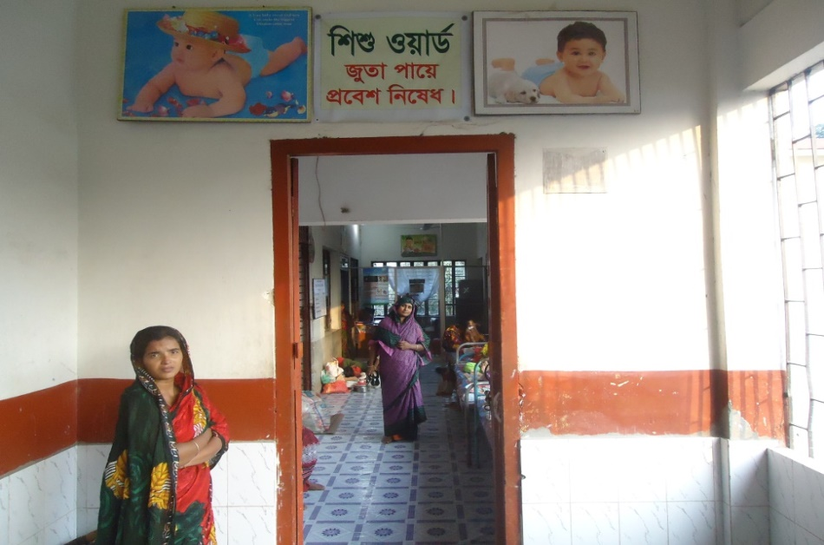
Improved EOC (Emergency Obstetric Care) word service.
Improved pediatric word.

Slide 33
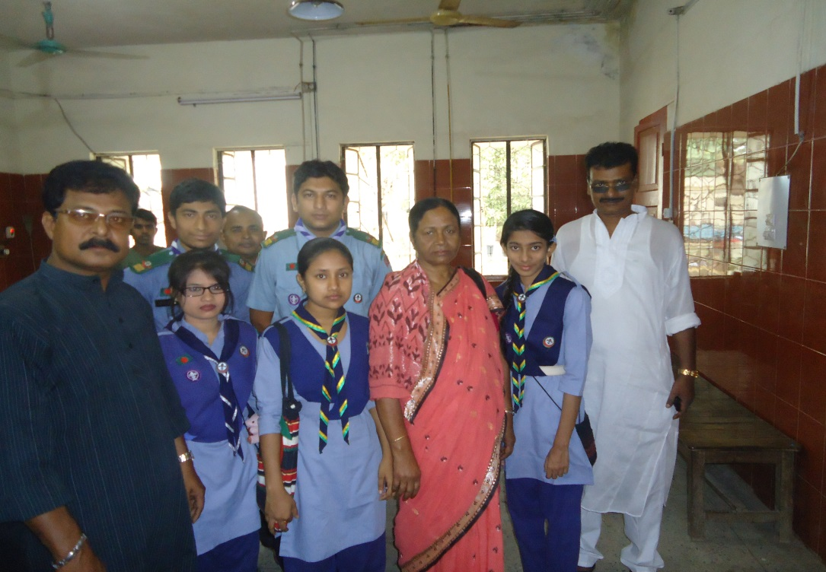
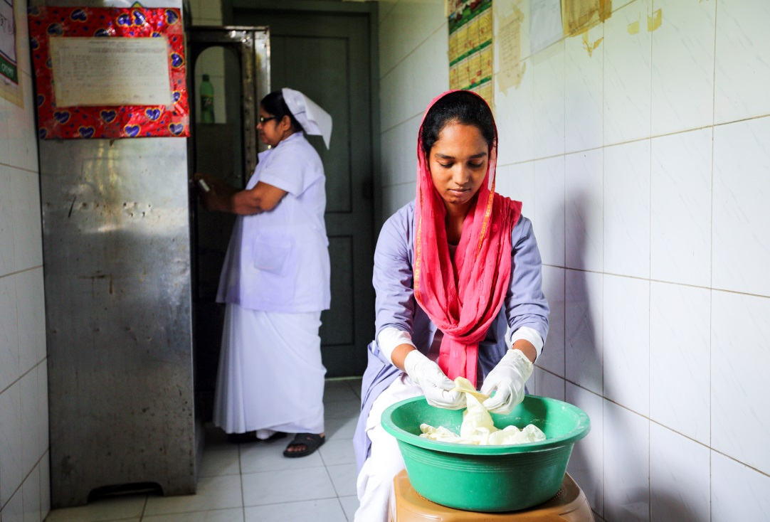
Girls’ Guide are working in the outdoor for lining of the patients to take proper service.
College going poor students are working in the hospital as nursing assistant (Volunteer).

Slide 34
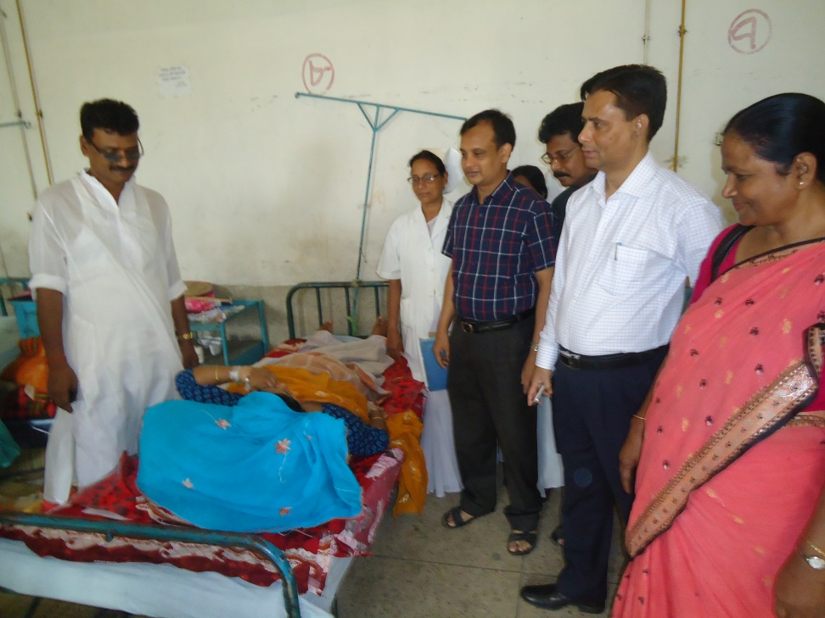
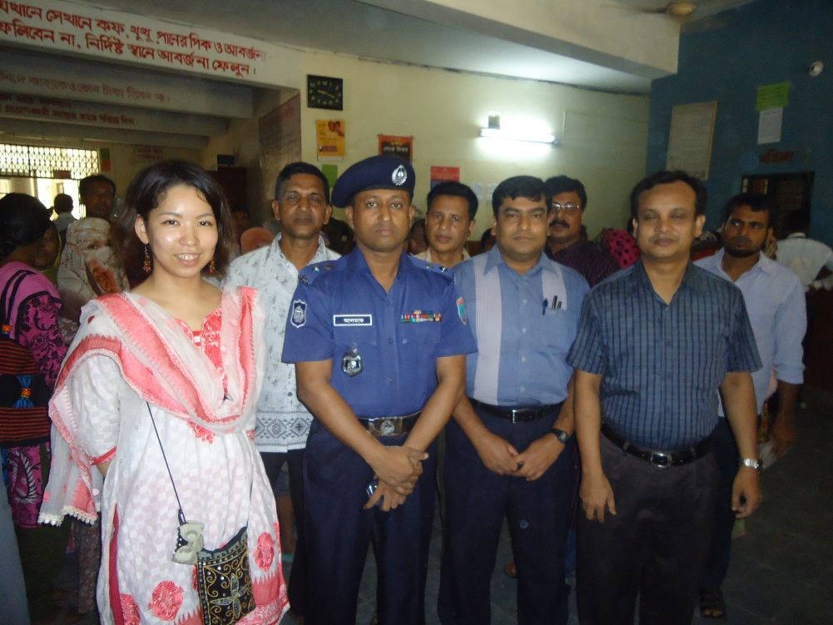
Deputy Commissioner (DC), Jhenaidah visited the Sadar Hospital to observe the Hospital activities.
Superintendent of Police (SP), Jhenaidah visited the Sadar Hospital to observe the Hospital activities and to ensure security of the hospital.

Slide 35
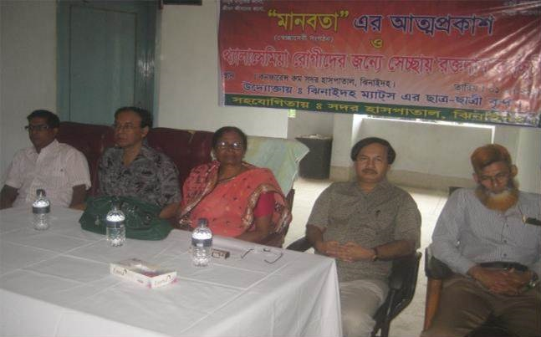
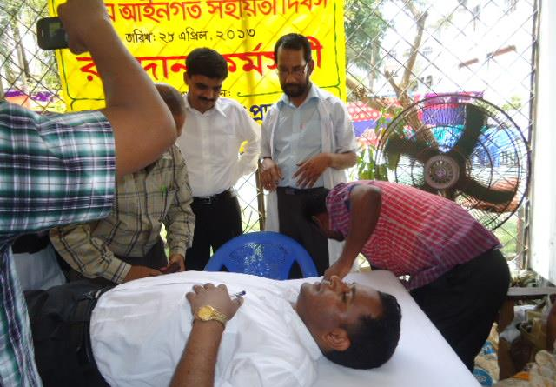
MANOBOTA- a volunteer blood donor organization has formed by the doctors and SACMOs to donate blood for the thalasemic and other patient of the hospital.
A blood donation camp arranged by District Judge of Jhenaidah with the help of MANOBOTA.

Slide 36
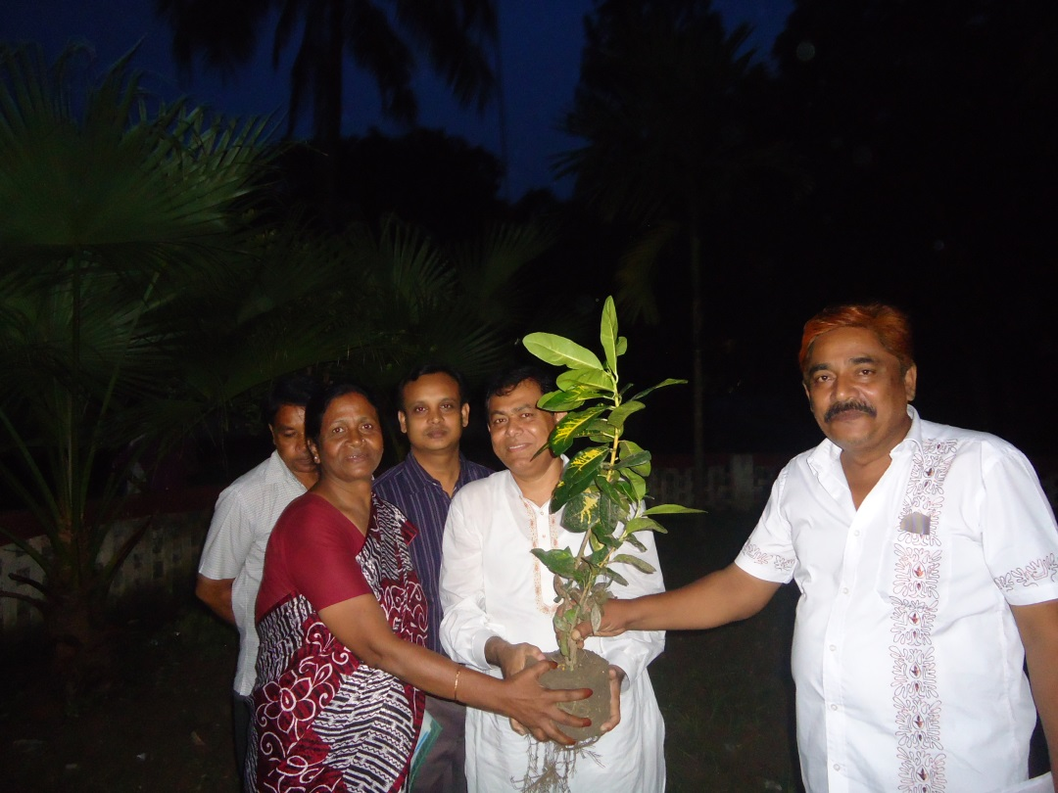
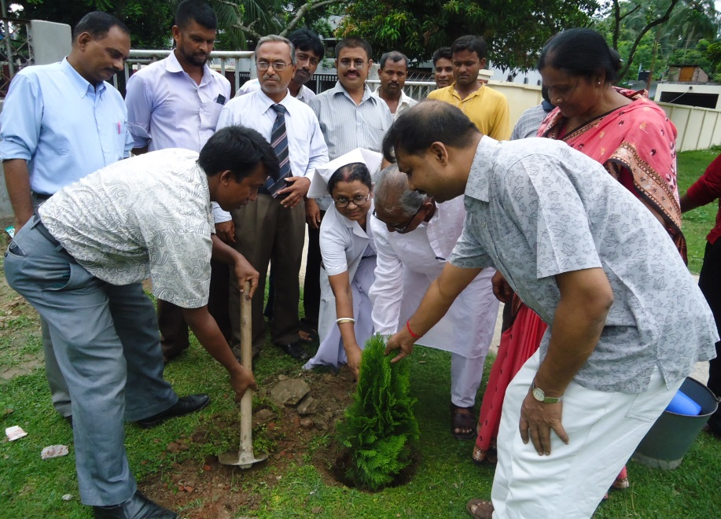
Hospital campus beautification started by previous MP of Jhenaidah-2.
Beautification plant is planted by Zilla Praised Administrator and Upazilla Praised Chairman.

Slide 37
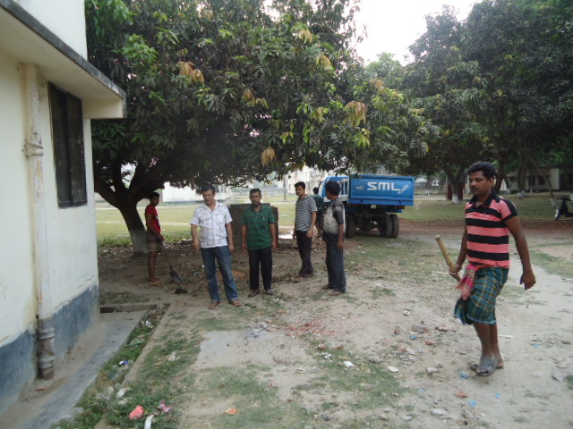

Hospital garbage is removed regularly by the Paurasava.
17th,March “a big cleaning day” is being celebrated to clean the hospital by DC, Mayor, Civil Surgeon & staffs of the hospital , under the leadership of Superintendent.

Slide 38


X-Ray Service system continued by the support of community in absence of supplying X-Ray film.
0.24 acre land of Jhenaidah Sadar Hospital has been saved from occupied with the support of Civil Surgeon, local administration, M.P. and Mayor.

Slide 39


Meeting of the stakeholders with the stakeholders and donors of Jhenaidah Sadar Hospital with additional secretary (health) Md. Asadul Islam.
Meeting of QIT (Quality Improvement Team) is held in the conference of Jhenaidah Sadar Hospital.

Slide 40




Changes in EOC Ward
Before
After
Before
After
Before
After

Slide 41








Changes in Surgery Ward

Slide 42




Changes in Padietric & Medicine Ward
Before
After
Before
After

Slide 43




Changes in Gardens of The Hospital
Before
After
Before
After

Slide 44




West Management & Campus Protection
Before
After
Before
After

Slide 45




Changes in office and hospital internal environment
Before
After
Before
After

Slide 46



Improved pediatric word by local initiative

Slide 47




Hospital Environment

Slide 48
Jhenaidah Sadar Hospital, Jhenaidah
Achievement of the Hospital
1. Active Community Participation in the hospital.
2. Improved performance of all services specially pediatric, obstetric and operation.
3. Improved cleanliness and beautification of the hospital.
4. Functioning of X-Ray service by local initiatives.
5. Improved security.
6. Improved financial management
7. The hospital is awarded 4 times from 2013 to 2016.

Slide 49


